Slide 1


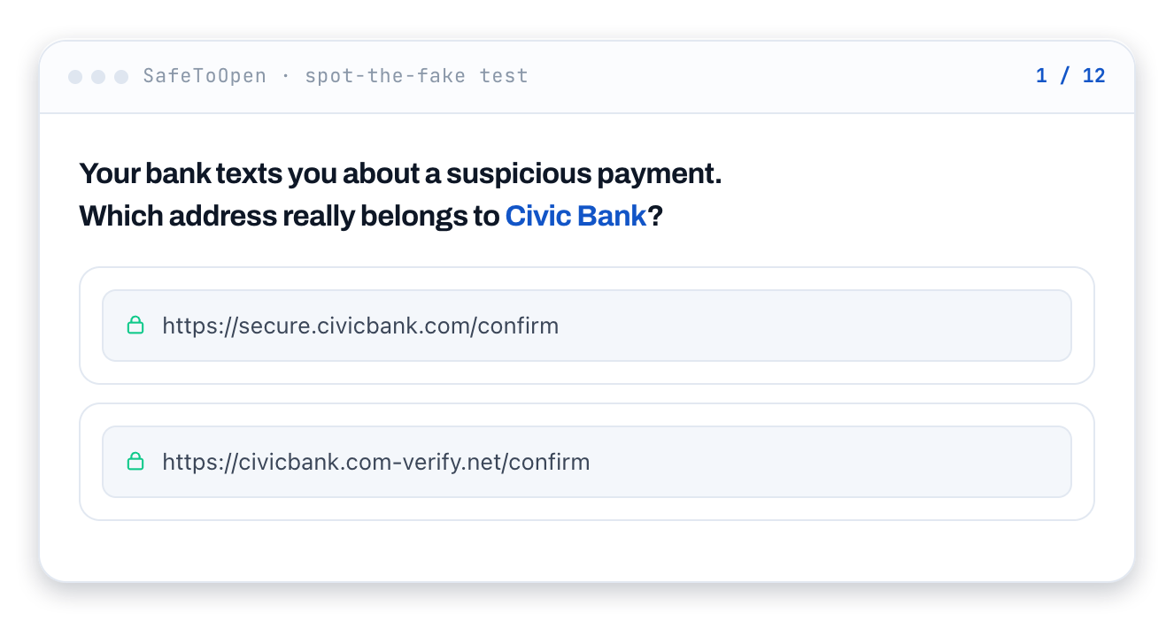
INTERNAL PRODUCT BRIEFING
Scam Check
A clearer picture of
our scam awareness
An open, timed assessment built from real scam techniques, presented under our own brand.
243
4–5 minutes
Our brand
Questions across 22 scam categories
Typical time for around ten questions
Our invitations and our choice of privacy mode
Prepared for [Organisation name]
Notes:
This is an internal proposal to measure scam recognition with an open assessment. People answer fictional examples based on real techniques, receive explanations and produce a score we can use to focus follow-up learning. The screenshots are examples from SafeToOpen’s public quiz rather than our campaign results.
Presenter guidance
Replace the organisation name. Allow about 20 minutes and invite everyone to vote on the live question before revealing the answer. Keep the tone supportive rather than punitive.
Sources
https://safetoopen.com/en/products/scam-check/

Slide 2
01 / THE BUSINESS CASE
Scam awareness needs evidence across channels
Our people encounter decisions in email, on phones, in QR links and through collaboration tools.
60%
Messages and payment requests
A sender, tone or change in instructions may be the only clue.
of breaches involved a human element in Verizon’s 2025 DBIR
Web pages and lookalike domains
A familiar brand can sit on an unrelated address.
Voice, QR codes and chat
Awareness needs to cover more than the inbox.
Source: Verizon 2025 DBIR Executive Summary. A human element is not the same as employee blame or training failure.
Scam Check
02
Notes:
Verizon’s 2025 report describes a human element in around 60% of breaches. This is historical context, not a prediction for us or a claim that people are to blame. Scam Check addresses a narrower question: which selected scam techniques can our participants recognise under a timed assessment? A test score is not a complete measure of real-world risk.
Presenter guidance
Ask which channels and decisions are relevant to our colleagues. Do not equate a missed quiz question with someone causing a breach.
Sources
https://www.verizon.com/business/resources/reports/2025-dbir-executive-summary.pdf
https://safetoopen.com/en/products/scam-check/

Slide 3
01 / THE MEASUREMENT GAP
Six distinctions that improve our awareness reporting
Different measures can be useful, provided we are clear about what each one actually demonstrates.
01
Participation
02
Opens and decisions
Someone who has not started is a separate group, not evidence of a correct decision.
A recorded open may come from a preview or scanner. An answer is an explicit choice.
03
Channel coverage
04
Trust and experience
An email exercise does not tell us everything about voice, QR, web and chat scams.
An openly explained test lets people understand the purpose and use of results.
05
Completion and competence
06
Change over time
A completed activity and a correct judgement are different pieces of evidence.
A reassessment needs comparable content, difficulty and participation.
Scam Check
03
Notes:
The goal is accurate interpretation rather than dismissing our existing programme. Training completion, simulations and scored assessments each provide evidence. An open assessment can make non-participation and explicit decisions visible across selected techniques. We should use it alongside an honest account of what was tested.
Presenter guidance
Discuss which distinctions matter in our existing report. Avoid claiming that every simulation tool treats silence as a pass or that all simulations only cover one channel.
Sources
https://safetoopen.com/en/products/scam-check/

Slide 4
01 / RESEARCH CONTEXT
A large trial found limited improvement from training
The result supports measuring outcomes in our own setting.
19,500+
8 months
10
Employees in one healthcare organisation
Randomised trial with control groups
Simulated phishing campaigns
1.7pp
What the study supports
Recent annual training showed no significant relationship with simulation failure. Embedded training showed a statistically significant but small average difference.
This was one setting. It did not evaluate Scam Check.
Average absolute difference in failure rates between embedded-training groups and the control group
Ho et al., Understanding the Efficacy of Phishing Training in Practice, IEEE S&P 2025. 1.7pp is an absolute gap.
Scam Check
04
Notes:
This healthcare trial used random assignment and a control group. The 1.7 percentage-point result is an average absolute gap. The annual-training result was an association test. The paper did not evaluate Scam Check.
Presenter guidance
Use the result as context for measuring our outcomes. Avoid generalising one study to every training programme.
Sources
https://www.sysnet.ucsd.edu/~voelker/pubs/phishtrain-oakland25.pdf
https://doi.org/10.1109/SP61157.2025.00076

Slide 5
02 / ASSESSMENT DESIGN
Scored decisions make the learning gaps visible
The assessment is open, timed and followed by feedback after each answer.
Measurement need | What Scam Check supplies | How we should use it
Participation | Not started versus completed | Know which groups our results represent.
Judgement | A score for explicit answers | Find techniques participants struggle to recognise.
Breadth | Multiple scam channels and regional content | Choose content relevant to our roles and exposure.
Learning | An explanation after each response | Discuss the tell behind the example.
Follow-up | Another campaign and comparable results | Assess change with context about content and participants.
A score measures performance on the chosen questions. It is not a guarantee of behaviour in every real attack.
Scam Check
05
Notes:
The assessment provides scored decisions and feedback across selected techniques. We should choose the question mix and reporting purpose before inviting people. A later campaign can help us review progress if scope and difficulty remain comparable. The result is a learning baseline rather than a complete risk score for an individual.
Presenter guidance
Agree how results will be explained and who can see them. Choose an accommodation route for people who need a different timing or access arrangement.
Sources
https://safetoopen.com/en/products/scam-check/

Slide 6
03 / LIVE EXERCISE
Which address belongs to Civic Bank?
A bank text asks us to check a suspicious payment. Vote before moving to the answer.
A
https://secure.civicbank.com/confirm
B
https://civicbank.com-verify.net/confirm
What made your choice feel trustworthy?
Fictional bank example from SafeToOpen’s public quiz. The addresses are exercise text, not links to open.
Scam Check
06
Notes:
Pause and let the room decide. Ask for A or B, then invite people to explain what they looked at. The fictional bank and addresses are exercise material. Do not reveal the answer until participants have had a chance to reason about it.
Presenter guidance
Use a show of hands or a chat vote without recording names. Do not open either address. If someone is unsure, explore the clue rather than identifying the person as a failure.
Sources
https://safetoopen.com/en/products/scam-check/

Slide 7
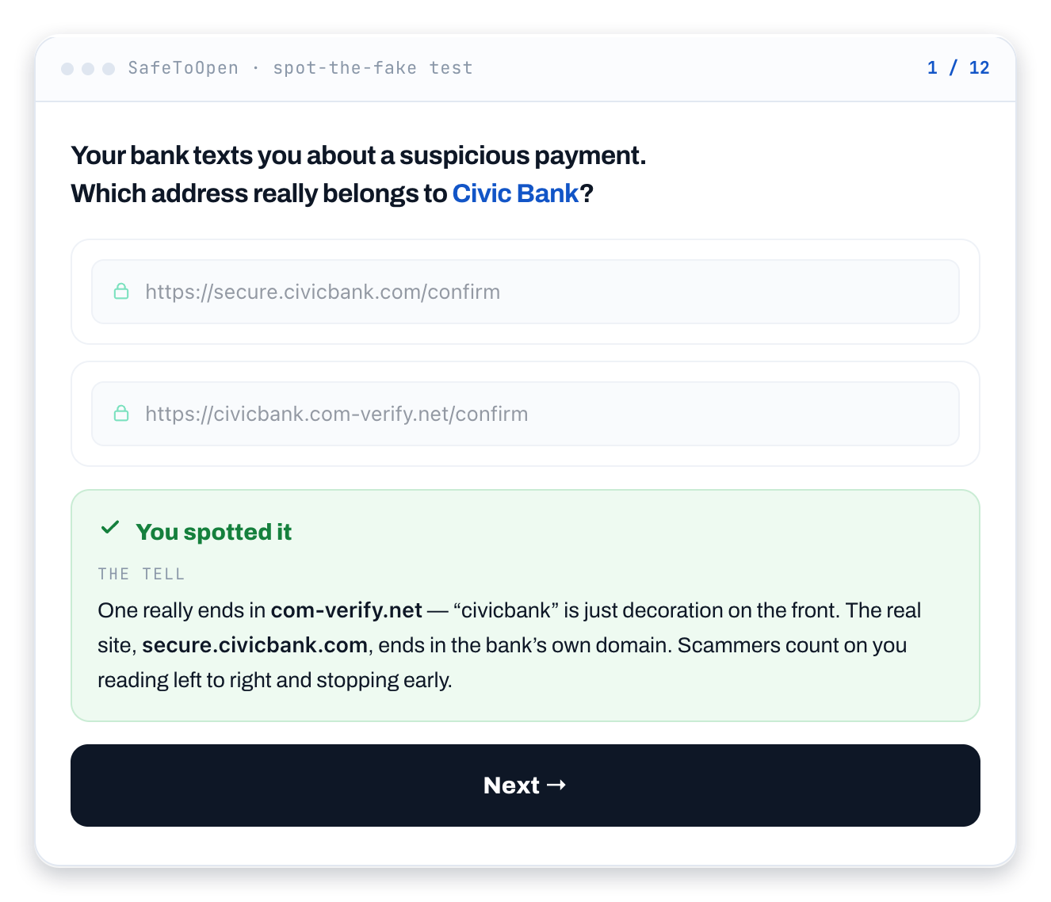
03 / THE ANSWER
The registered domain is the clue
A is the intended answer
secure.civicbank.com
civicbank.com is the bank’s domain in this exercise. “secure” is a subdomain.
Why B is different
Its registered domain is com-verify.net. The bank’s name appears before a different domain.
Scam Check
07
Notes:
A is the exercise’s intended answer. The bank’s domain is civicbank.com and secure is a subdomain. B has com-verify.net as its registered domain. The familiar bank word in front is not proof of ownership. Domain recognition is one useful signal, not a universal guarantee that a site is safe.
Presenter guidance
Ask what made B plausible. Connect the explanation to independent verification of a bank alert through an app or contact route already known to be genuine.
Sources
https://safetoopen.com/en/products/scam-check/

Slide 8
04 / THE PARTICIPANT EXPERIENCE
Our brand, an open invitation and immediate feedback
The campaign can look and sound like an activity from our own organisation.
Invitation from us
Our branded test
A different question mix
Feedback after answers
Our sender and an explanation of purpose and privacy
Our logo, colours, selected questions and timer
A personal link and the subset we choose to serve
The tell and the reasoning behind each example
What we explain before people start
Why we are running it, whether participation is required, who sees the results and where to ask for help.
Nothing for recipients to install. Around ten questions typically take four to five minutes.
Scam Check
08
Notes:
We apply our name, logo and colours and send invitations ourselves. People know they are taking an assessment. We can select a different subset of questions for each recipient. Feedback explains the technique after each answer. The invitation needs to make the purpose and privacy understandable.
Presenter guidance
Agree the sender, invitation wording, accessibility or timing accommodations and participant contact. Do not promise that different question subsets make answer-sharing impossible.
Sources
https://safetoopen.com/en/products/scam-check/

Slide 9
04 / CAMPAIGN ADMINISTRATION
A campaign our own team can build and run
Question selection, branding, privacy, distribution and review stay under our organisation’s control.
Choose and brand
Set up and send
Read and follow up
Question bank or our own content
Regional pack and visual identity
Privacy mode and timer
Unique links from our own address
Dashboard and export
Hardest techniques and timeouts
Before launch | Before invitations | After the campaign
Choose the learning goal and question balance. Review the wording. | Test a link, explain the privacy mode and choose a closing date. | Discuss aggregate gaps and agree focused follow-up.
Up to 20 questions in the campaign pool, including our own. No mail server change or recipient installation.
Scam Check
09
Notes:
The builder supports question selection, regional packs, custom questions, our branding and privacy settings. We distribute personal links ourselves and can serve different subsets from the pool. The results help us choose follow-up. A campaign can be straightforward to configure, but our own approval, content review and invitation process still need owners.
Presenter guidance
Name the campaign owner, content reviewer, sender and results reviewer. Test the full experience before distribution and confirm the current question limits and available features.
Sources
https://safetoopen.com/en/products/scam-check/

Slide 10
04 / THE QUESTION BANK
243 questions across 22 scam categories
A bank refreshed monthly, with regional packs for New Zealand, Australia, the UK, the US and Canada.
243 questions in total. The bank is refreshed monthly, so the counts change over time.
Scam Check
10
Notes:
The bank contains 243 questions across these 22 categories. We should choose a balanced set relevant to our colleagues rather than selecting only the hardest questions. The bank refreshes monthly, so the current count can change.
Presenter guidance
Review regional context and the channels our people use. Keep later reassessments comparable if we want to interpret a change in score.
Sources
https://safetoopen.com/en/products/scam-check/

Slide 11
05 / RESULTS AND FOLLOW-UP
The results should lead to a useful next conversation
Participation, score distributions, difficult questions and timings guide the next learning action.
What we receive | What it can reveal | Our follow-up
Participation status | Which people or groups our completed results represent | Close participation gaps and state the denominator.
Score distribution | A baseline across the selected techniques | Discuss the pattern without reducing people to a risk label.
Hardest questions / channels | Where the examples most often cause difficulty | Use those techniques in focused follow-up learning.
Time taken / timeouts | Where participants hesitate or run out of time | Check clarity, time budget and accommodations.
A later campaign can test change, with comparable content and participation.
Scam Check
11
Notes:
The product reports scores, distributions, question and channel difficulty, timing and campaign exports. These can support our evidence record and follow-up. A later result needs comparable content, difficulty and participants to support an interpretation of change. Improved assessment performance alone does not prove that real-world losses have fallen.
Presenter guidance
Decide who sees individual versus aggregate results before launch. Exports may support an audit or insurance evidence request, but acceptance depends on the actual requirement.
Sources
https://safetoopen.com/en/products/scam-check/

Slide 12
05 / PRIVACY CHOICES
We choose how results identify participants
The mode determines address handling. Every mode still records answers, scores and timings.
Mode | Email address handling | How we use the results
Named | Store the address with the campaign record | Results can link to each person.
Pseudonymous | Use the address to generate a link, without saving it | Use campaign identifiers rather than stored addresses.
Anonymous | No address required. Participants enter by code. | Review scores and gaps without stored names.
Our real messages stay outside the test
Questions are fictional examples. We send invitations ourselves.
Scam Check
12
Notes:
Scam Check offers named, pseudonymous and anonymous modes. In every mode the system records the answers, score and time per question. Recipient IP address, device and location are never recorded, and SafeToOpen never emails our recipients. We should agree the privacy mode and reporting purpose with the relevant teams.
Presenter guidance
Explain the mode in the invitation. Avoid claiming that responses can never identify someone indirectly, especially in a very small group. Select access and reporting groups that fit our purpose.
Sources
https://safetoopen.com/en/products/scam-check/
https://safetoopen.com/en/trust-privacy/

Slide 13
06 / COMMERCIAL MODEL
A free first campaign, then payment per campaign
Standalone campaigns are priced by the number of people tested. The first run lets us evaluate the real workflow.
First campaign
Paid campaigns
Up to 25 people
10 questions
Priced per person tested. See current rates at safetoopen.com/en/products/scam-check
One free campaign per organisation. A card is required, with nothing charged for that campaign.
Confirm current pricing and terms before activation.
Scam Check
13
Notes:
Scam Check offers one free first campaign for up to 25 people and ten questions, with a card required and no charge for that run. Paid campaigns are priced per person tested: check the current rates on the product page before presenting. Confirm current terms and any Business Plus entitlements.
Presenter guidance
Discuss current pricing and terms before activating a campaign. Do not imply the suggested pilot obliges us to buy a later campaign.
Sources
https://safetoopen.com/en/products/scam-check/

Slide 14
07 / PROPOSED FIRST CAMPAIGN
One department, a clear purpose and a review date
The proposal is to establish a useful baseline, then choose whether and how to expand.
Agree
Build
Invite
Review
Department, owner, privacy mode and reporting purpose
Balanced questions, regional context and our branding
Our sender, purpose, closing date and a help contact
Participation, hard techniques and focused follow-up
At the review
Which groups participated?
Which techniques need a clearer explanation?
What will we change before a wider campaign or reassessment?
A supportive assessment and practical learning plan. Participation, accessibility and privacy choices need clear owners.
Scam Check
14
Notes:
The suggested decision is to run the free first campaign with one department, review participation and results, then decide whether a wider campaign is useful. Choose the privacy mode and purpose before invitations. The important outcome is a specific learning conversation, not a ranking that embarrasses colleagues.
Presenter guidance
Record the campaign owner, group, mode, invitation date, close date and review date. Product details: https://safetoopen.com/en/products/scam-check/ . Contact: contact@safetoopen.com.
Sources
https://safetoopen.com/en/products/scam-check/

