Slide 1


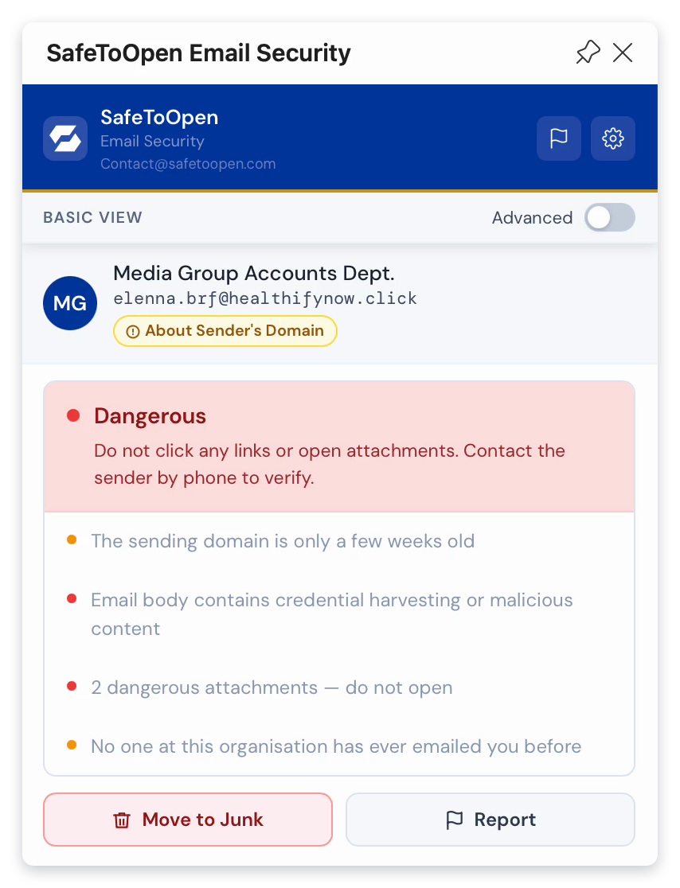
INTERNAL PRODUCT BRIEFING
Email Security
A clearer answer
before we act
One-click verification inside Outlook and Gmail, with evidence for the person deciding what to do.
Up to 71
Outlook + Gmail
Plus / Executive
Checks combined into an explained verdict
Desktop, web and mobile support
Protection matched to our people and roles
Prepared for [Organisation name]
Notes:
This is an internal case for adding SafeToOpen verification inside the email clients we use. We will look at business email compromise, the product workflow, the checks and plans, deployment, data handling and a focused pilot. The product images are SafeToOpen demonstrations rather than our results.
Presenter guidance
Replace the organisation name. Allow about 20 minutes including the walkthrough. Identify our current email filter and payment-verification process before presenting.
Sources
https://safetoopen.com/en/products/email-security/

Slide 2
01 / THE FINANCIAL EXPOSURE
Business email compromise targets a business decision
A believable payment request can cause harm without a malicious attachment or a fake sign-in link.
US$3.05bn
“Our bank details
have changed.”
Losses reported to FBI IC3 for business email compromise in 2025
The sender can be a compromised supplier account. The request can look familiar.
Our independent payment checks remain essential.
Source: FBI IC3 2025 Annual Report, pp. 8 and 26. Reported complaint losses, not all global losses. Chart: US$ billions.
Email Security
02
Notes:
IC3 lists business email compromise losses of $3,046,598,558 in 2025 and $2,770,151,146 in 2024. These are complaint losses reported to IC3, not total global losses or losses SafeToOpen could necessarily prevent. The example illustrates why a colleague needs to assess a business request as well as its technical payload.
Presenter guidance
Ask how we verify bank-detail changes today. Keep independent callbacks and approval controls in place. Do not present a trust score as payment authorisation.
Sources
https://www.ic3.gov/AnnualReport/Reports/2025_IC3Report.pdf
https://safetoopen.com/en/products/email-security/

Slide 3
01 / ATTACK SCENARIOS
Three requests that deserve a second check
Executive impersonation
Supplier payment change
Account phishing
“Please make this
payment urgently.”
“Use our new
bank account.”
“Your account will
be suspended.”
A lookalike sender or an impersonated leader asks for an unusual transfer.
A genuine supplier’s compromised mailbox sends revised banking instructions.
A branded message links to an imitation sign-in page or risky attachment.
Signals to inspect
Signals to inspect
Signals to inspect
Sender authentication
Domain similarity
First-time sender
Urgency and payment context
Bank-detail change request
Thread context
Sender-history anomaly
Message patterns
URL and domain context
Authentication signals
Attachment analysis
Urgency language
Email Security
03
Notes:
These examples come from the product scenarios and are not incidents attributed to our organisation. A sender can be impersonated, lookalike or genuinely compromised. SafeToOpen can combine technical signals with request and message context. No single signal proves that a request is fraudulent.
Presenter guidance
Invite a sanitised example relevant to our teams. Explain why a compromised real account can require a different kind of review from a misspelled sender domain.
Sources
https://safetoopen.com/en/products/email-security/

Slide 4
02 / THE EMPLOYEE WORKFLOW
Verification where people already read email
The person stays in Outlook or Gmail and sees a score, reasons and available actions.
01
Open the message
Typical verdict
A tone, request, link or attachment deserves a closer look.
<3 seconds
02
Verify with SafeToOpen
The sender, links, attachments and message signals contribute to the verdict.
Analysis pre-loads when the message opens. Timing varies with the message and connection.
03
Read the reason and act
Follow the recommendation and our reporting or approval process.
No forwarding or copying the message into a separate user dashboard.
Email Security
04
Notes:
The product offers a short verification step inside the email client. The typical verdict takes under three seconds, with analysis pre-loading when the message opens. The person should inspect the reasons and act through our approved process. A score supports judgement rather than replacing identity verification or financial approvals.
Presenter guidance
Use an approved sample and test mailbox. Show the add-in entry point and where the recommendation appears. If live access is unavailable, use the product captures.
Sources
https://safetoopen.com/en/products/email-security/

Slide 5
02 / DETECTION EVIDENCE
Up to 71 checks, with the reason beside the message
The signal mix covers sender identity, domain context, message content, links and attachments.
Plus
61 checks
Executive
Adds 10 Deeper Analysis checks
Email Security
05
Notes:
The published breakdown totals 71: 14 link checks, 12 authentication and header checks, 10 domain checks, 10 content checks, 8 attachment checks, 7 sender-history checks and 10 Executive Deeper Analysis checks. Plus excludes those ten Executive checks. These are category counts, not a detection accuracy measure.
Presenter guidance
Relate the chart to the actual verification panel. The user sees reasons and recommended actions rather than a list of all individual checks. Confirm plan details before activation.
Sources
https://safetoopen.com/en/products/email-security/

Slide 6
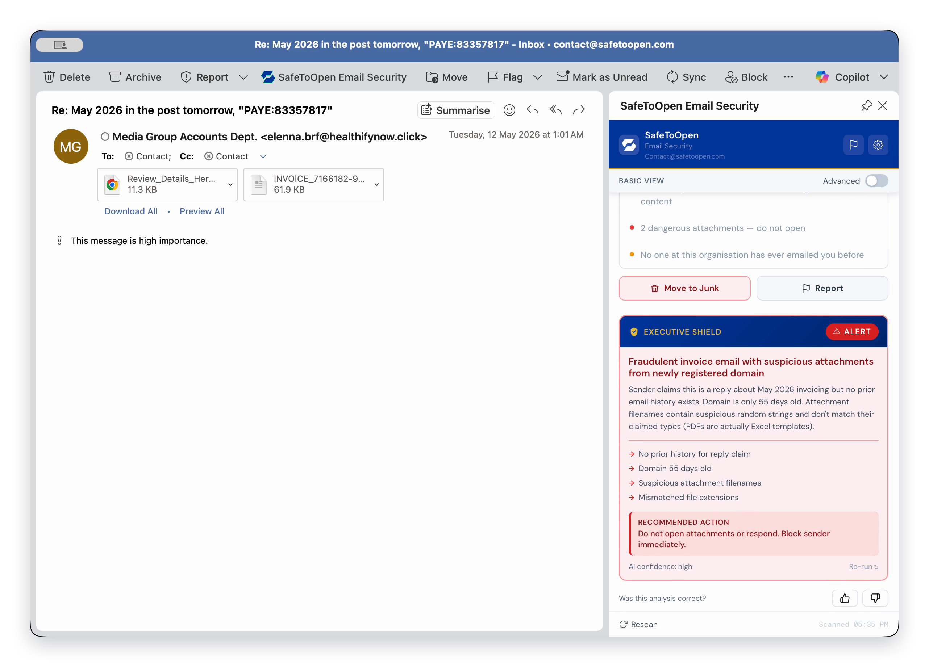
03 / PRODUCT DEMONSTRATION
Deeper Analysis adds context to a targeted request
01
Technical reasons
The panel flags suspicious sender, domain and attachment signals.
1
02
Executive analysis
2
Message-body and sender-pattern analysis adds context for targeted attacks.
03
A recommended next step
Stop, verify independently and use the reporting action appropriate to our process.
3
Email Security
06
Notes:
This Outlook capture shows a suspicious invoice conversation and the Executive Shield area. Deeper Analysis can examine message-body and sender-pattern context, supporting detection of targeted requests such as impersonation or business email compromise. The example is not a measured result from our organisation.
Presenter guidance
Walk through the three callouts. The exact mailbox actions should align with our own reporting process. Do not open the suspicious sender domain or attachment from a live example.
Sources
https://safetoopen.com/en/products/email-security/

Slide 7
03 / THE DECISION AFTER THE VERDICT
How the verdict supports our business process
The key behaviour is verification before a high-impact action, with an understandable route for uncertainty.
Read the evidence
Verify the request
Use our process
Check the specific reasons. A score alone does not explain every risk.
For payment or access changes, use an independent, trusted contact route.
Report, move to junk or escalate through our agreed internal route.
Examples of high-impact decisions
New supplier details
Urgent transfers
Requests for sensitive information
Unexpected account-access changes
Email Security
07
Notes:
A helpful result changes the next business decision. The person should read the reasons, verify a high-impact request through a trusted route and follow our reporting procedure. An apparently favourable verdict does not authorise a payment or guarantee that a message is legitimate.
Presenter guidance
This is a suggested process for our organisation, not a claim about a product-enforced workflow. Replace the generic reporting route with our actual instructions in the presenter’s talk track.
Sources
https://safetoopen.com/en/products/email-security/

Slide 8
04 / PLAN FIT
Plus and Executive serve different levels of scrutiny
The plan choice determines the available checks. Match it to roles and exposure.
Capability / fit | Plus | Executive
Core verification | Sender, domain, link, attachment, content and history checks | All Plus checks
Published check count | 61, excluding Deeper Analysis | Up to 71, including Deeper Analysis
Full AI body analysis | Not included in the published Plus breakdown | 10 additional Deeper Analysis checks
Roles to consider | People who need routine message verification | Finance, leaders, assistants and other likely targets
Our pilot question | Does routine verification help our normal workflows? | Does the extra context help on targeted requests?
Confirm business entitlements, pricing and trial terms before activation.
Email Security
08
Notes:
The published breakdown assigns 61 checks to Plus and adds ten Deeper Analysis checks for Executive, making up to 71. Executive’s full message-body analysis is relevant to targeted requests, but our choice should reflect actual roles and workflow needs. Current licensing, support and business-plan entitlements need confirmation.
Presenter guidance
Select comparable sample messages for the two plan types. Avoid promising a precise detection uplift merely because the check count is higher.
Sources
https://safetoopen.com/en/products/email-security/

Slide 9
04 / CLIENT COVERAGE AND DEPLOYMENT
Admin deployment without changing the mail route
Both supported ecosystems cover desktop or web use and mobile reading.
Microsoft 365
Google Workspace
Microsoft 365 Admin Centre
Google Workspace Marketplace
Outlook for Windows and macOS
Outlook on the web
Outlook on iOS and Android
Gmail on the web
Gmail mobile app
Link safety badges in the inbox
Rollout checks
Permissions, pilot mailboxes, representative clients, a safe sample and our reporting route.
No mail-flow changes or new on-premise infrastructure. Allow for our own administrator and application approvals.
Email Security
09
Notes:
Outlook is supported on desktop, web and mobile. Gmail is supported on web and mobile. Administrators deploy through the Microsoft 365 Admin Centre or Google Workspace Marketplace without rerouting mail. Deployment itself is quick, but our own permission review and rollout process still apply.
Presenter guidance
Identify our platform, mailbox group, client versions, administrator and permissions. Test one representative desktop and mobile workflow before broad rollout.
Sources
https://safetoopen.com/en/products/email-security/

Slide 10
04 / FIT WITH EXISTING CONTROLS
An additional verification step beside the message
Our current filtering, anti-malware and approval controls continue to do their jobs.
Layer | Its continuing role | SafeToOpen’s additional role
Gateway / mailbox controls | Filtering, malicious content inspection and quarantine | A user-visible verification experience for a message in the inbox
Endpoint protection | Device, application and file safeguards | Further email and attachment-related signals inside the client
Financial approvals | Independent checks for payment and supplier changes | Reasons that can prompt the person to stop and verify
Security reporting | Our incident and response process | In-client actions that can feed our agreed reporting behaviour
The pilot tests the additional benefit in our own configuration.
Email Security
10
Notes:
Modern mail security already provides multiple detection methods. SafeToOpen should be evaluated for the additional explanations and verification behaviour it brings to a message that reaches a person’s inbox. Keep the existing filter, endpoint protection and business approvals. Product integration and behavioural fit should be demonstrated rather than assumed.
Presenter guidance
Name our existing tools. Ask the team what extra evidence would help with a believable invoice, supplier change or account request.
Sources
https://safetoopen.com/en/products/email-security/

Slide 11
05 / DATA HANDLING AND ASSURANCE
Data handling must match the workflow we enable
Verifying a message and reporting one are handled differently.
Published commitments
How each workflow is handled
New Zealand hosting
Workflow | How it is handled
Routine verification | Not stored: analysed in transit, metadata anonymised
Report action | Kept 90 days for analysis and audit, then deleted
Administration | Agreed at setup: admin access and who sees reports
All customer data is hosted in New Zealand.
No customer data for AI training
Customer material is not used to train SafeToOpen’s models.
Independently certified
ISO/IEC 27001:2022 certified and Google CASA verified. A DPA and security review material are available.
Full detail: safetoopen.com/en/trust/data-handling
Email Security
11
Notes:
When a person verifies a message, its content is analysed in transit and never stored, and scan metadata is anonymised. A message someone chooses to report is kept for 90 days for analysis and an audit trail, then deleted; confirmed-malicious indicators are kept as threat intelligence. Customer data is not used for AI training, and all customer data is hosted in New Zealand. SafeToOpen is ISO/IEC 27001:2022 certified and verified under Google’s CASA security assessment.
Presenter guidance
Explain the difference between verifying a message, which is not stored, and reporting one, which is kept for 90 days. Agree who can report messages and how reports reach our security team.
Sources
https://safetoopen.com/en/trust/data-handling/
https://safetoopen.com/en/trust/ai-transparency/
https://safetoopen.com/en/trust/
https://safetoopen.com/en/products/email-security/

Slide 12
06 / PROPOSED PILOT
A focused pilot with the people most exposed
Finance, accounts payable, executives and assistants are sensible groups to consider.
Prepare
Demonstrate
Observe
Review
Owner, mailboxes, permissions, privacy and safe samples
Verification, reasons, Executive context and reporting
Use before high-impact actions, clarity and false alarms
Support effort, plan fit and wider rollout decision
Suggested two-week review
Can people explain the warning?
Did verification fit the payment and reporting process?
What useful detections, exceptions or support questions did we review?
Free trial, no credit card required. Confirm trial terms and Plus / Executive licence costs before activation.
Email Security
12
Notes:
The proposal is a small evaluation with people who regularly receive high-impact requests. Two weeks is a suggested internal review period, not a statement about the trial entitlement. Judge clarity, adoption, false alarms, support effort and the usefulness of any Executive context. Wider rollout would follow a separate decision.
Presenter guidance
Record the sponsor, IT owner, privacy reviewer, selected mailboxes, start date, review date and success criteria. Product details: https://safetoopen.com/en/products/email-security/ . Contact: contact@safetoopen.com.
Sources
https://safetoopen.com/en/products/email-security/

Slide 13
APPENDIX / PRESENTER Q&A
Questions to prepare for before the demonstration
Does this replace our spam filter?
Does a favourable verdict approve a payment?
No. It adds verification inside the email client alongside existing filtering and endpoint safeguards.
No. Our independent payment-verification and approval processes still apply.
Which plan includes full body analysis?
Can we use it on a phone?
The published breakdown adds full AI body analysis through Executive Deeper Analysis. Confirm business entitlements.
Outlook mobile and the Gmail mobile app are supported. Test the clients our pilot actually uses.
What should we demonstrate?
What remains to confirm before rollout?
An approved sample, where to verify, the reasons, Deeper Analysis if enabled, and our reporting route.
Permissions, scan versus report retention, attachment handling, trial terms and licence costs.
Email Security
13
Notes:
Keep this slide as a presenter reference or use it for questions. The important distinction is between a technical verdict and our business process. This briefing is a product evaluation, not an assurance that a message can never be malicious.
Presenter guidance
If a detailed question concerns our tenant or privacy agreement, record it and ask SafeToOpen for a workflow-specific answer.
Sources
https://safetoopen.com/en/products/email-security/
https://safetoopen.com/en/trust/data-handling/

