Slide 1


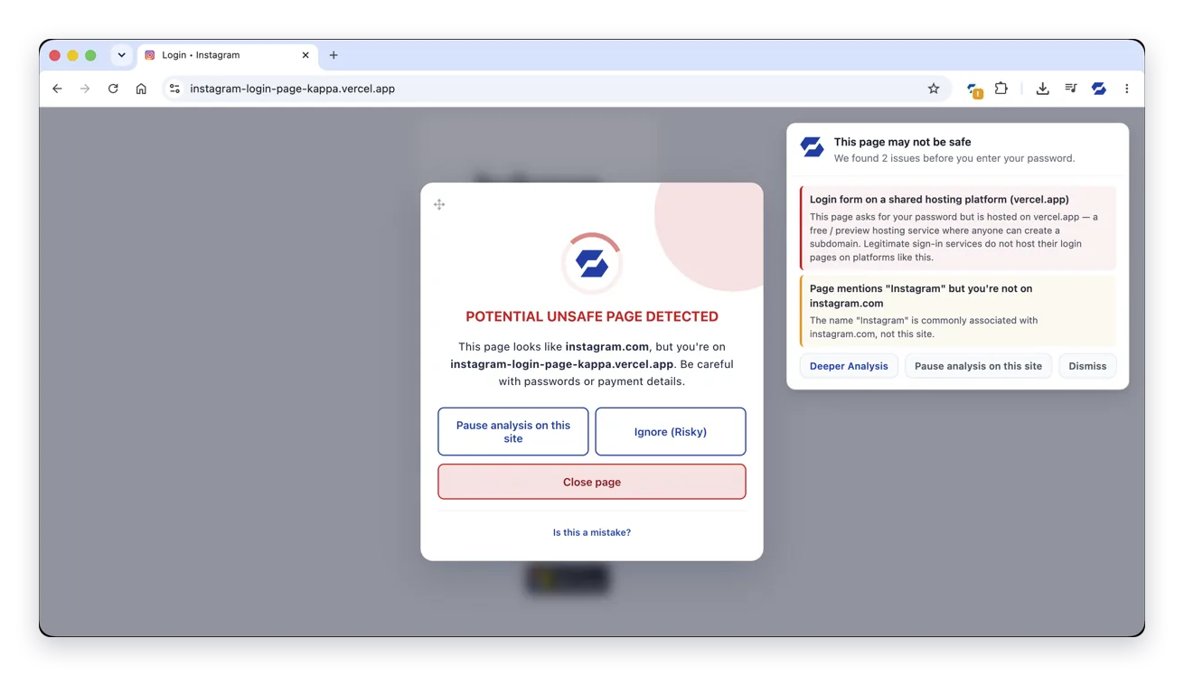
INTERNAL PRODUCT BRIEFING
Browser Security
Phishing protection
at the point of risk
How it protects our people, what they will see, and how we operate it in our environment.
40,000+
80+
Local first
Brands covered by impersonation detection
Policy controls per workspace
Sensitive form values remain on the device
Prepared for [Organisation name]
Notes:
Our proposal is to evaluate browser protection at the moment a person reaches a suspicious page. This briefing explains the product, the employee experience, its operational controls and the decision we would make after a pilot. The product screens are SafeToOpen demonstrations, not our organisation’s results.
Presenter guidance
Replace the organisation name. Allow about 20 minutes including the demonstration. Tailor the deployment discussion to our browsers, identity provider and incident process. The last slide supports Q&A. Superior scores or return on investment are not assumed.
Sources
https://safetoopen.com/en/products/browser-security/business/

Slide 2
01 / THE BUSINESS CASE
What this would add to our security
The focus is the decision between arriving on a page and sharing credentials or sensitive data.
Protection for our people
Control for IT and security
New or unfamiliar pages
Managed deployment
Page appearance and behaviour can contribute evidence beyond a previously reported URL.
Workspace policies, Entra ID group mapping and organisation-wide URL lists.
A warning they can act on
Actionable security events
An explanation beside the page, with a clear route to close it or report a mistake.
Triage and forensic context, with SIEM exports and signed webhooks to our tools.
Proposed next step: evaluate one team, its normal workflows and our ability to support the product.
Browser Security
02
Notes:
There are two parts to the business case. The first is an understandable intervention when a person is about to trust a page. The second is the ability for our organisation to deploy, tune and investigate those interventions. Browser Security should fit alongside existing defences. The pilot would show whether these capabilities add useful protection in our environment.
Presenter guidance
Discuss the people and workflows most exposed to browser phishing. Examples could include finance, shared-file workflows or colleagues who regularly scan QR codes. Avoid asserting that existing controls cannot detect new threats.
Sources
https://safetoopen.com/en/products/browser-security/business/
https://safetoopen.com/en/products/browser-security/

Slide 3
01 / THE BUSINESS CASE
A phishing decision can unfold in under a minute
Historical phishing-exercise data shows why a warning needs to reach the person immediately.
0
21s
+28s
Message opened
Link clicked
Data entered
A convincing request reaches the inbox.
21 seconds after opening, at the median.
A further 28 seconds after clicking, at the median.
Why this matters here
Links arrive through email, SMS, QR codes and chat. The browser is another place to interrupt a convincing scam before the next action.
Source: Verizon 2024 DBIR, p. 40. Separate medians from contributed phishing-exercise data.
Browser Security
03
Notes:
Verizon reports a median 21 seconds from opening a phishing email to clicking and a further median 28 seconds from clicking to entering data. These are separate stage medians and should not be presented as a measured 49-second median for the combined journey. The source describes the overall pace as less than a minute. The practical implication is that an intervention needs to happen while the person is on the page.
Presenter guidance
Explain the distinction between the two medians if asked. These data do not predict our organisation’s response time and are not a SafeToOpen performance test.
Sources
https://www.verizon.com/business/resources/reports/2024-dbir-data-breach-investigations-report.pdf

Slide 4
01 / COVERAGE IN OUR ENVIRONMENT
How this fits with the controls we already use
The additional layer is page-level assessment and an explanation at the moment of risk.
Control layer | What it already contributes | What we would add
Email security | Message, sender and link checks | Page checks from email and other channels
URL / DNS controls | Reputation and destination rules | More evidence from suspicious pages
Endpoint protection | Device, app and file protection | Impersonation and data-entry safeguards
MFA / access | Stronger account authentication | Warnings before trusting a suspicious page
Awareness training | Recognition and safer habits | An explanation during the actual decision
Our existing controls remain in place. Evaluate overlap and added value against our actual configuration.
Browser Security
04
Notes:
Our existing controls may already provide some browser and phishing protection. This table identifies the role we would evaluate for SafeToOpen rather than claiming that other products rely only on lists. The extension adds page and user-action signals in the browser. Strong authentication, including phishing-resistant MFA where available, remains important.
Presenter guidance
Name our current email, identity, endpoint and URL controls. Ask IT to identify overlap and any deployment constraints before selecting the pilot group.
Sources
https://safetoopen.com/en/products/browser-security/business/
https://safetoopen.com/en/products/browser-security/

Slide 5
02 / DETECTION ARCHITECTURE
The detection layers behind a browser warning
Local page analysis, threat intelligence and visual checks contribute different signals.
IN OUR BROWSER
WHEN MORE EVIDENCE IS NEEDED
WHAT OUR PEOPLE SEE
Threat intelligence
Additional analysis when local evidence is insufficient
Employee warning
Known malicious URL checks
Reasons and safe actions
VisionAI analysis
Local inspection
Visual elements and URL
Brand and sign-in patterns
40,000+ brands covered
Flagged security event
X-Ray code and structure
Sensitive-value safeguards
Triage, evidence and export
Business policy
80+ workspace controls, exclusions, URL lists and scoped event visibility
Sensitive form values stay local. Cloud submissions and flagged events have their own retention rules.
Browser Security
05
Notes:
SafeToOpen combines local and cloud checks. X-Ray inspects page code and structure in the browser. When a page cannot be cleared locally, VisionAI may receive visual elements and the URL to assess impersonation. Policy influences detection and reporting. This is a conceptual product flow, not a network or timing specification.
Presenter guidance
Use the diagram to explain why local-first protection can still involve a cloud submission. Confirm policies, exclusions and retention for our environment before activation.
Sources
https://safetoopen.com/en/trust/ai-transparency/
https://safetoopen.com/en/trust/data-handling/
https://safetoopen.com/en/products/browser-security/business/

Slide 6
03 / PRODUCT DEMONSTRATION
A familiar brand on an unrelated domain
01
Identity mismatch
The page names Instagram, but the host is not instagram.com.
2
02
Visible evidence
1
The panel explains the hosting and brand signals in plain language.
03
A clear next action
3
Close the page or report a suspected false alarm.
Browser Security
06
Notes:
The demonstration shows a fake Instagram sign-in. The warning identifies the mismatch between the claimed brand and host, lists its reasons, and makes the safe action visible. A user can report a possible false positive. This is a demonstration example, not a detection from our organisation.
Presenter guidance
Walk through the three numbered callouts. Never open the displayed suspicious address during a presentation. Ask a colleague to explain the recommended next action.
Sources
https://safetoopen.com/en/products/browser-security/

Slide 7
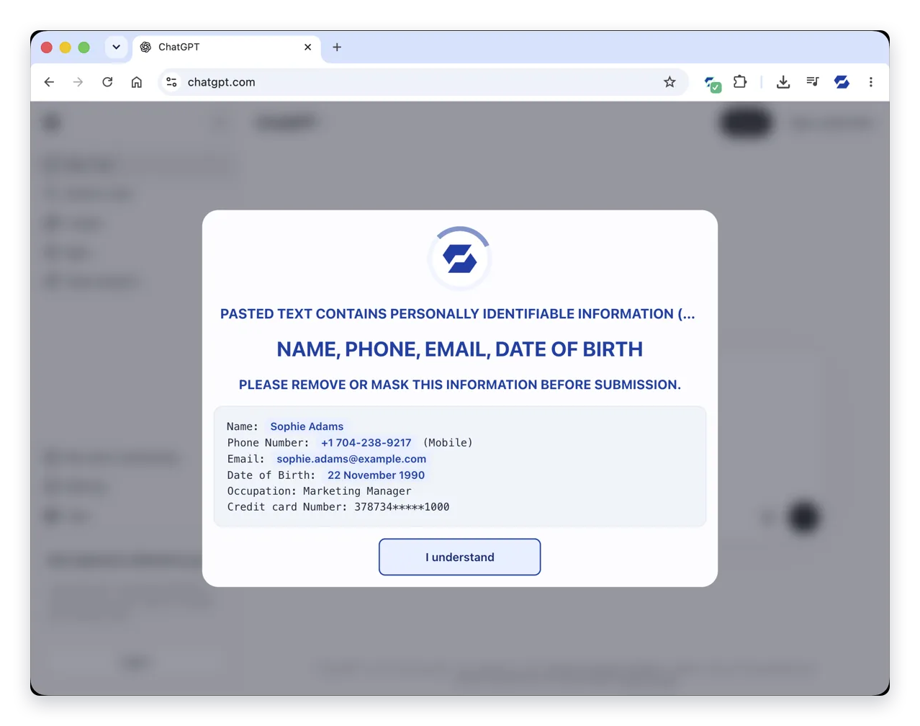
03 / SAFEGUARDS AROUND RISKY ACTIONS
Five safeguards for credentials, data and access
Credential warnings
Warns before credentials reach a flagged sign-in page.
Paste Guard
Checks sensitive data before pasting into a site or AI tool.
ClickFix guard
Addresses pages that persuade people to run a command.
OAuth consent guard
Warns before an app receives lasting mailbox or file access.
Password Alert
Flags our work password outside approved sign-in pages.
Plan dependent: Plus / Business for Paste Guard, ClickFix and consent guards. Password Alert uses Business policy.
Browser Security
07
Notes:
SafeToOpen provides five safeguards around risky browser actions. Credential warnings apply to flagged pages. Paste Guard checks sensitive values locally. ClickFix targets deceptive command instructions, while OAuth consent protection addresses access grants. Password Alert is a Business workspace policy. We should select policies that fit our approved workflows.
Presenter guidance
Explain the Paste Guard capture without entering real customer data. Ask where our staff can paste personal data, card data or confidential material. Confirm exact plan inclusions and policy behaviour during setup.
Sources
https://safetoopen.com/en/products/browser-security/
https://safetoopen.com/en/trust/data-handling/

Slide 8
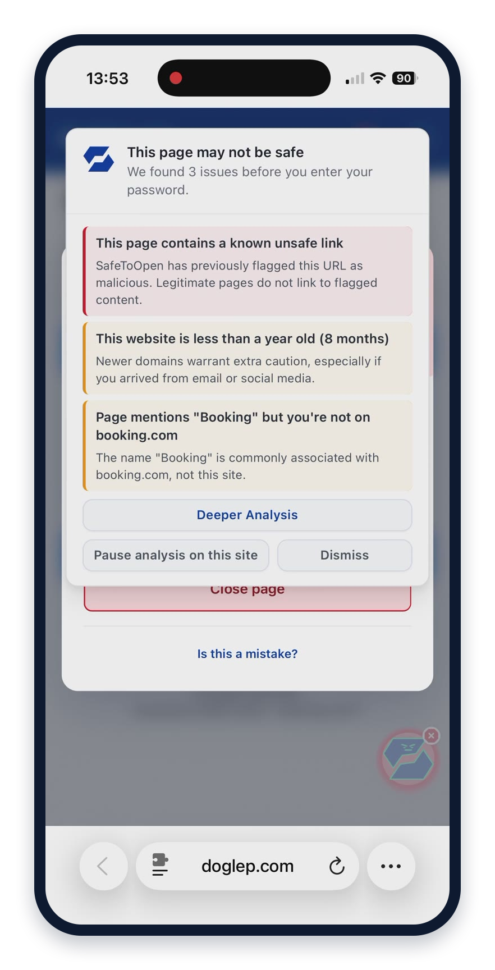
03 / DESKTOP AND MOBILE COVERAGE
Protection across the browsers our people use
The device fleet determines where we can deploy and how we demonstrate the experience.
Environment | Supported browsers
Desktop | Chrome, Edge, Safari and Firefox
iPhone / iPad | Safari
Android | Edge and Firefox
A mobile example
A Booking.com imitation triggers the same kind of plain-language warning inside Safari on iPhone.
Browser Security
08
Notes:
SafeToOpen supports Chrome, Edge, Safari and Firefox on desktop, Safari on iPhone and iPad, and Edge and Firefox on Android. The image shows a Booking.com imitation in Safari on iPhone. Browser availability does not guarantee that every feature is identical on each platform, so we should check the specific guards and management path we intend to use.
Presenter guidance
Ask IT to list our managed browsers and mobile policies. Select representative devices for the pilot and confirm feature parity where it matters. The image is a product demonstration, not an incident from our organisation.
Sources
https://safetoopen.com/en/products/browser-security/
https://safetoopen.com/en/trust/data-handling/

Slide 9
04 / DEPLOYMENT AND ADMINISTRATION
Identity, workspaces and policy in one rollout
The cloud service uses our existing browser management and an organisation-specific policy setup.
Microsoft 365 / Entra ID
Our workspaces
Protected browsers
Map groups and workspace membership. Automate joiners and leavers.
80+ policy controls
Allow / block lists
Scoped administrative roles
Managed install or approved link. Policy updates reach the fleet.
Before deployment
During operation
Choose the group, supported browsers, internal exclusions and reporting policy.
Track fleet coverage, tune exceptions and keep administrative changes in the audit trail.
Fully SaaS with no on-premise server to run. Our own permissions and rollout approvals still apply.
Browser Security
09
Notes:
Deployment can use managed-browser tooling or a simple installation link. Microsoft 365 integration maps Entra ID groups into workspaces and supports membership changes. Each workspace can have its own policies, lists and roles. There is no SafeToOpen server for us to host. We should still run our normal permission and application approval process.
Presenter guidance
Agree the IT owner, security owner, group mapping, exclusions, extension policy and support process. Treat same-day installation as a technical capability rather than a promise about our full internal approval timeline.
Sources
https://safetoopen.com/en/products/browser-security/business/

Slide 10
04 / SECURITY OPERATIONS
How a flagged incident reaches our response process
The console supports investigation, while exports and webhooks connect to the tools our team already uses.
Capture
Triage
Investigate
Respond
Flagged URL, reasons and event context
Review status, analyst and decision
Page elements, network and hosting context
Our SIEM, ticketing or SOAR workflow
SIEM export API
Signed webhooks
Threat intelligence
JSON, OCSF, ECS or CEF
Splunk, Sentinel, Elastic, QRadar
Incident delivery to ServiceNow, Jira, a SOAR or an HTTPS collector
STIX 2.1 bundles and TAXII 2.1 collections for compatible platforms
Flagged events support response. Routine browsing does not become an employee browsing-history feed.
Browser Security
10
Notes:
The console provides event triage and forensic context. Its export API supports SIEM ingestion formats and signed webhooks can push incidents into ticketing or automation. Threat indicators can also use STIX/TAXII. Some integrations can feed resolution state back to SafeToOpen. Our team must configure and validate the workflow; product support for an integration is not a completed integration in our tenant.
Presenter guidance
Select one event destination for the pilot. Check access scope, token rotation, alert routing, deduplication and who closes the incident. Hostile URLs and code should remain inert during demonstrations.
Sources
https://safetoopen.com/en/products/browser-security/business/

Slide 11
05 / PRIVACY AND ASSURANCE
What stays local, what can leave and what is retained
Local safeguards, cloud submissions and security-event records have different handling rules.
Data / activity | Processing and handling | Our deployment choice
Page code and form values | Local inspection. Sensitive values do not leave the browser. | Confirm enabled guards and approved workflows.
VisionAI submission | URL and visual elements may leave when local checks need more evidence. | Agree internal-domain exclusions and retention.
Flagged incidents | Security evidence supports triage and investigation. | Scope analyst access and review retention.
Ordinary browsing history | Not exposed as a routine browsing feed. History checks use one-way hashes. | Explain the distinction to our people.
New Zealand hosting
Customer data is not used for AI training
ISO/IEC 27001:2022 certified · DPA available
Browser Security
11
Notes:
The detailed statement says local page inspection and sensitive-value checks happen in the browser. VisionAI submissions can include a URL and visual elements, with deletion within 30 days while confirmed malicious pages may remain as threat intelligence. Business security-event records have their own retention and access controls. Customer data is not used for model training. New Zealand hosting and a DPA support the review.
Presenter guidance
Confirm internal exclusions, cloud submission rules, event retention, administrator visibility and the current assurance documents. Do not promise that all analysis data disappears immediately. SafeToOpen is ISO/IEC 27001:2022 certified; that certification covers SafeToOpen’s own security management and does not by itself establish our compliance.
Sources
https://safetoopen.com/en/trust/data-handling/
https://safetoopen.com/en/trust/ai-transparency/
https://safetoopen.com/en/trust/

Slide 12
06 / WHY SAFETOOPEN
Four capabilities worth evaluating together
The combination matters: detection, explanation, organisational control and a manageable deployment.
Evidence beyond known URLs
Reasons people can understand
VisionAI and code inspection add context for suspicious pages.
The person sees why the page is suspicious and what to do.
Test with approved examples and reviewed events.
Ask people to explain their next action.
Central policy and response
Local-first processing
Workspace policies, roles, audit records and event integrations.
Sensitive-value checks stay on device. Exclusions support our internal apps.
Check the policy and incident workflow in our tools.
Review the actual data flow and retention settings.
Browser Security
12
Notes:
These capabilities provide a way to assess the product as a whole. We should look at the quality of a detection and explanation, not just event volume. Operational fit includes policy, access, integrations and support effort. Privacy fit includes local handling and the cloud data flow. The pilot is where these capabilities become evidence for our specific organisation.
Presenter guidance
Ask the sponsor which criteria matter most. Keep the distinction between product capability, a demonstration and observed results from our own pilot.
Sources
https://safetoopen.com/en/products/browser-security/business/
https://safetoopen.com/en/products/browser-security/
https://safetoopen.com/en/trust/data-handling/

Slide 13
07 / PROPOSED PILOT
A two-week evaluation with a defined decision
One team, representative workflows and a named review owner.
Scope
Prepare
Operate
Decide
Pilot group, browsers, owner and review date
Privacy settings, policies and approved demo examples
Coverage, useful warnings, false alarms and support
Review evidence and choose the next deployment step
Evidence at review | Practical question
Protection and clarity | Did reviewed warnings help people choose a safe next action?
Operational fit | Did it work with our applications and incident process?
Support effort | What exceptions, false alarms or user questions did we handle?
Business Plus free trial available. Confirm current trial terms, plan inclusions and licence costs before activation.
Browser Security
13
Notes:
The requested decision is approval to scope a limited pilot, not a commitment to wider deployment. Two weeks is a suggested internal evaluation period rather than a statement about the trial entitlement. Agree useful evidence before installation. A short pilot tests fit and usability, not a guaranteed reduction in breaches.
Presenter guidance
Record the sponsor, IT owner, security reviewer, group, start date, review date and criteria. Product details: https://safetoopen.com/en/products/browser-security/business/ . Contact: contact@safetoopen.com.
Sources
https://safetoopen.com/en/products/browser-security/business/

Slide 14
APPENDIX / PRESENTER Q&A
Questions our teams are likely to ask
Does this replace our existing tools?
What happens after a false alarm?
No. Keep email security, endpoint controls, MFA and awareness training. Evaluate the extra browser layer.
Users can report a mistake. Administrators can review events and manage URL exceptions.
Can we exclude internal applications?
Will managers see normal browsing?
Internal-domain exclusions are available. Agree them during deployment planning.
The product does not provide a routine browsing-history feed. Flagged incidents and technical data have defined handling.
Do we need a new server?
How do we choose policies and plans?
No on-premise infrastructure is required. The extension and cloud console still need our deployment approval.
Match the plan and workspace controls to our actual browsers, safeguards and operational requirements.
Browser Security
14
Notes:
Use this slide for questions or keep it as a presenter reference. These answers describe the product at a high level. Our deployment, retention and integration choices require our own owners. Confirm plan details rather than assuming every feature is identical across browsers.
Presenter guidance
If a detailed technical question remains, record the exact workflow or requirement and use SafeToOpen’s published documentation or security review pack. Do not invent a guarantee.
Sources
https://safetoopen.com/en/products/browser-security/business/
https://safetoopen.com/en/products/browser-security/
https://safetoopen.com/en/trust/data-handling/

